Slide 1
Why Axis? Explores the Boston Marathon
DATS 6101: Mid-Term Presentation
October 15, 2019

Slide 2
Boston Marathon Data
Our group chose to analyze data from the Boston Marathon in 2015-2017. Most of our work focuses on 2017, but we conducted analysis across all three years of data. The total size of the dataset is about 26,000 rows with 25 fields for each year. Fields include demographic information (age, gender, hometown and/or country) for each runner, the finishing time for each runner, and periodic times runners reached certain milestones along the course.
Boston Marathon Quick Facts
Oldest continually-run marathon in the world.
Attracts elite runners.
Must qualify with a previous Marathon, with qualifying times in the top 3-5% of all marathon times.
About 20% of participants are “charity” runners.
Geoffrey Kirui, of Kenya, beat American Galen Rupp by 21 seconds to win the Boston Marathon.

Slide 3
Boston Marathon Data
Our group was interested in determining what makes a runner fast based on the data we have? How much role, if any, does gender, age, past runnings of Boston, nationality, or home state determine a runners finial finishing time? To answer this, our team broke this question into its component pieces.
Analysis of gender, age and interim rankings (Kay)
Additional analysis of age (Hemanth)
Analysis of past races (Akhil)
Analysis of nationality (Ruijin)
Analysis of home state (Patrick)

Slide 4
Gender, Age, and Interim Ranking Analysis
Do men and women perform differently? Are men and women different in age? Are these differences statistically significant?
Is there a relationship between performance at half time (minutes it take to get to half) and official time (time it take to finish the race)? Does age affect official time?
Does your performance during each quarter of the race (rank at each quarter, only looking at the segment it take to run that quarter) impact your final rank?

Slide 5
Women’s age (x=39.9) is significantly different from men’s age (x=44.8) (p<0.001).
Women’s average official time (x=249) is significantly different from men’s average official time (x=229) (p<0.001).
Women’s average half time (x=117) is significantly different from men’s average half time (x=105) (p<0.001).
In a model exploring half time’s relationship with official time, slope/intercept value is -3.04 and is significant (p<.001). One minute increase in half time positively impacts (+2.18) official time (p<0.001). Adjusted R squared is high at 0.894.
In a model exploring the participants age in relationship with official time, slope/intercept value is 202.66 and is significant (p<.001). One year increase in age increases 0.8313 minute (=49.88 seconds) official time (p<0.001). Adjusted R squared is low at 0.0507.

Slide 6
Interim Ranking Analysis
Data set contained time at each interval (5k, 10k, 15k…). I explored how people did during each quarter of the race, not considering how they did before or after that quarter.
In a model exploring relationship between Rank at each segments of race (0-10K, 10-20K, 20-30K, 30-42.195K) and Overall Rank, slope/intercept value is -.0686 and is significant (p<.001). One rank increase during the first quarter of the race (0-10K) impacts (+0.186) overall rank (p<0.001).
One rank increase during the second quarter of the race (10-20K) increases (+0.175) overall rank (p<0.001).
One rank increase during the third quarter of the race (20-30K) increases (+0.291) overall rank (p<0.001).
And the final quarter seems to have the highest impact on the overall rank; one rank increase during the last quarter of the race (30-42.195K) increases (+0.400) overall rank (p<0.001).
Adjusted R squared is high at 0.99. There is concerning amount of collinearity with rank between 10-20K (vif=23.77) and rank between 20-30K (vif=17.98).

Slide 7
Additional Age Analysis
Are the average finishing times across different age groups different?
Are there any trends across different age groups ?
Is Age really a factor in deciding the finishing time of the marathon (Well, this boston marathon) ?

Slide 8
Additional Age Analysis
We preformed an ANOVA test across all the age groups, and found a pvalue less than the significant level 0.05. We can formally reject the null hypothesis that there is no difference between the means.
However, after reviewing the Tukey comparison of means, most of the difference was in older runners above 55. If we exclude them, an ANOVA test across the remaining groups finds a high pvalue of .253, suggesting there is no significant difference below age 55.

Slide 9
Analysis of Past Races
Is there any age group which is performing better across all three years?
Any trends in the Average official time for top four countries with highest number of runners over the three years?
Are the means of official time for the year’s 2015, 2016 and 2017 the same?
Is the performance of the third time runners better than the first time runners?

Slide 10
Analysis of Past Races
As we can see from the plot, there is very slight increase in average official time for top four countries with highest number of runners over the three years.
ANOVA analysis of the three means of the finishing time returned a high p value, meaning we fail to reject the null hypothesis that the means from the three years are the same.
In a z-test of average finishing times between first-time runners and repeat runners, we found a low p value which means we reject the null that there is no difference between the means.

Slide 11
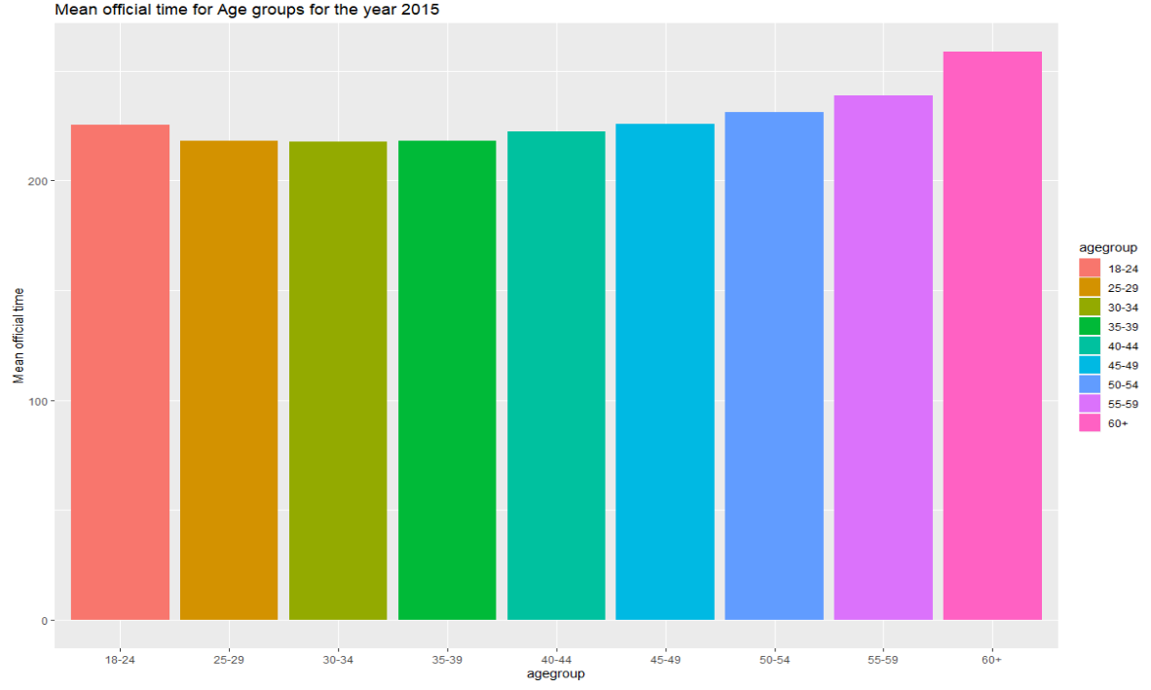
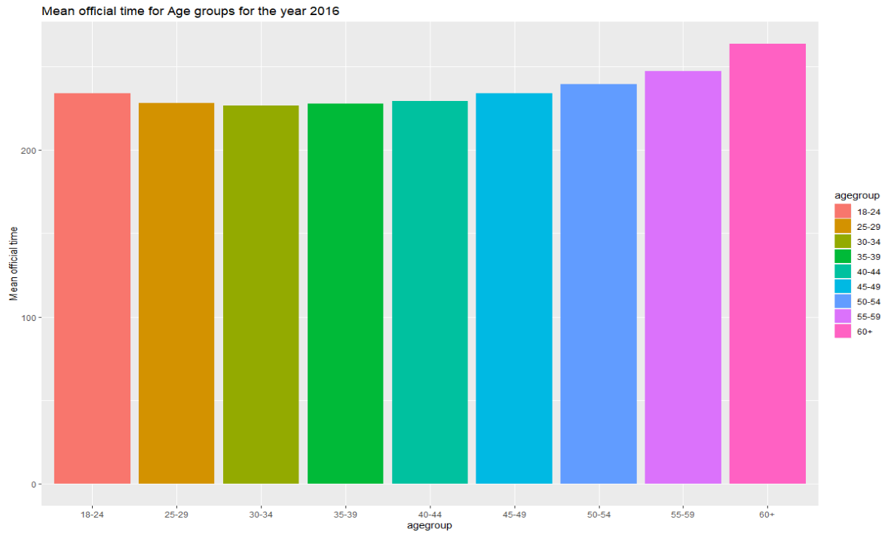
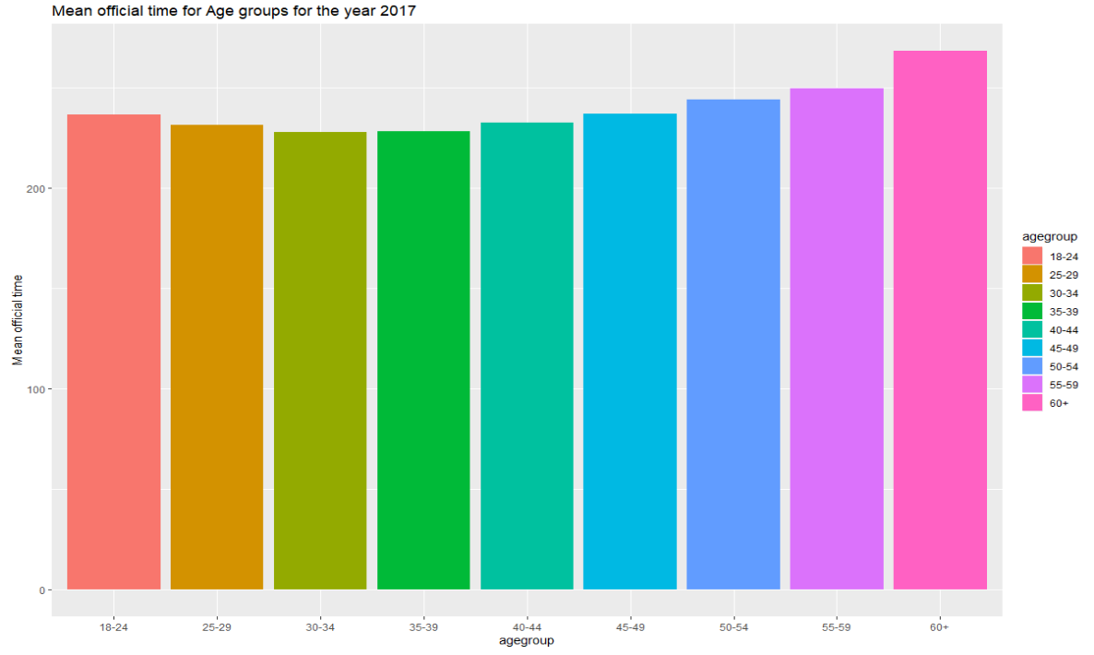
Analysis of Past Races
Performance of 30-34 age group is better compared to other age groups across all the years

Slide 12
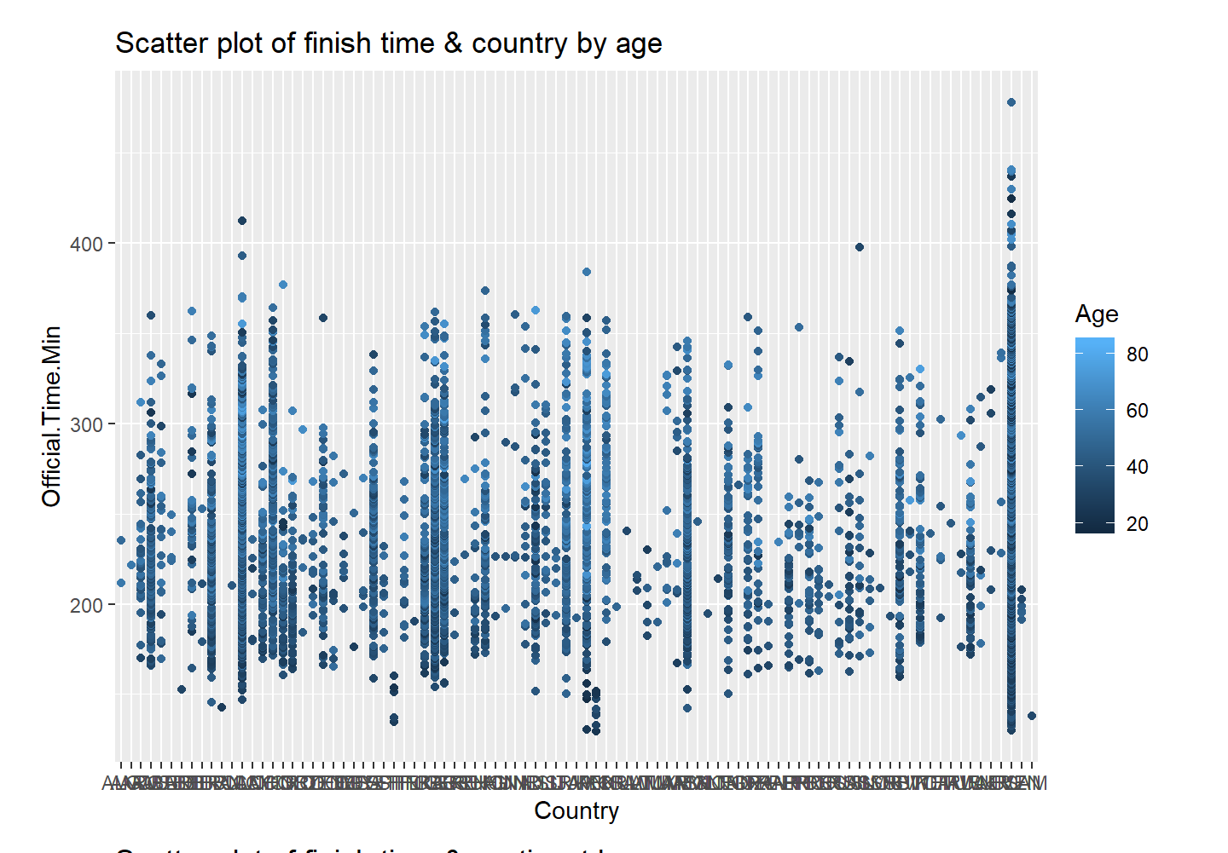
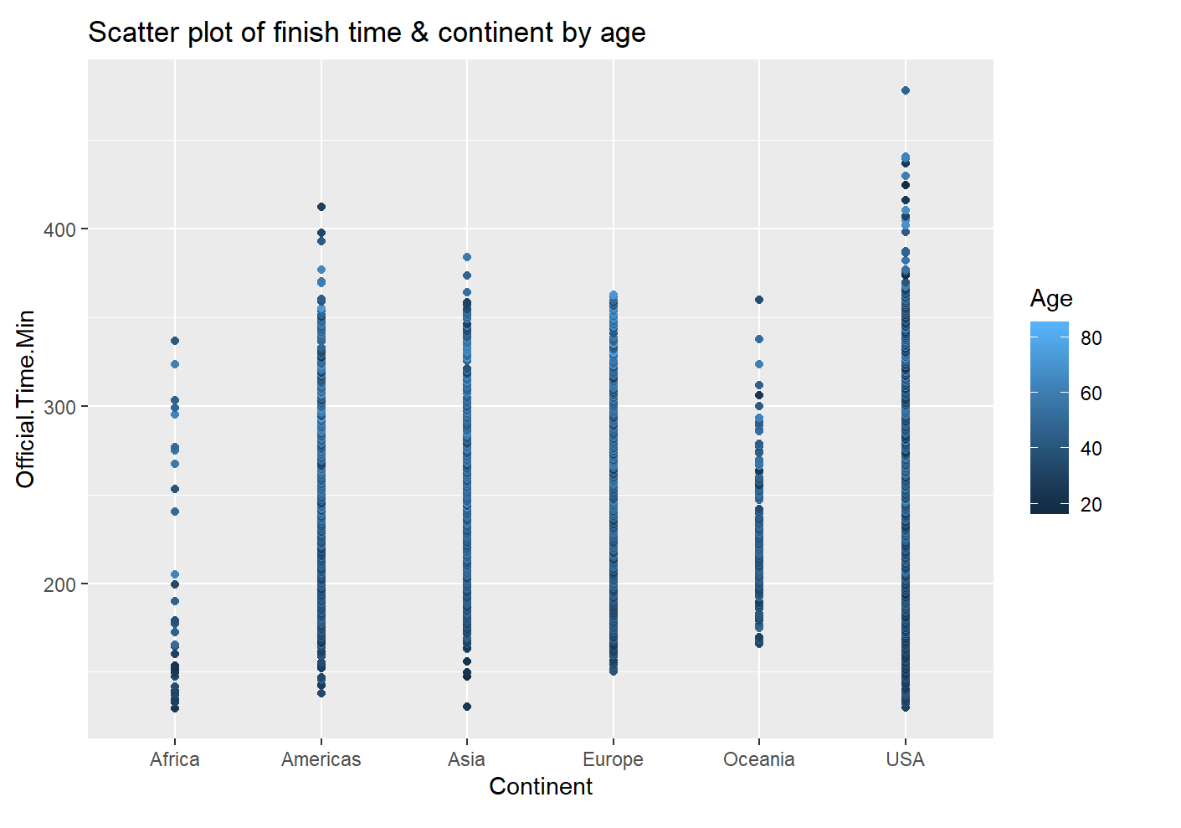
Nationality/Continent Analysis
Will nationality affect finishing time? Specific questions include:
Is marathon time same in different nationality/continents? If not, how is the difference?
Will the difference exist among fast runners?
Would nationality/continent be independent with finish time?

Slide 13
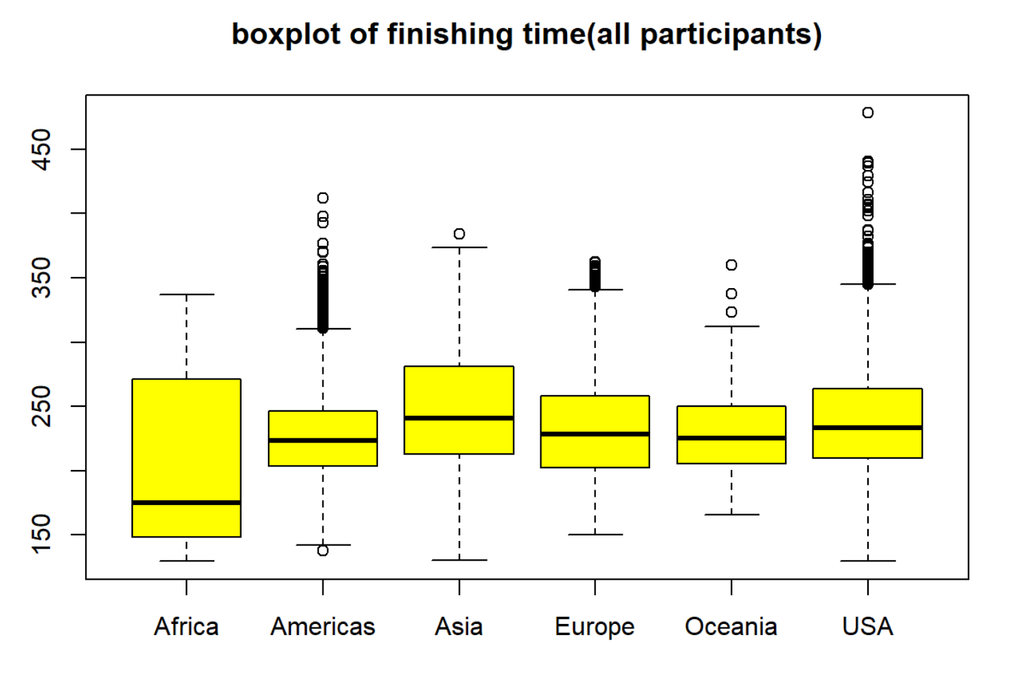
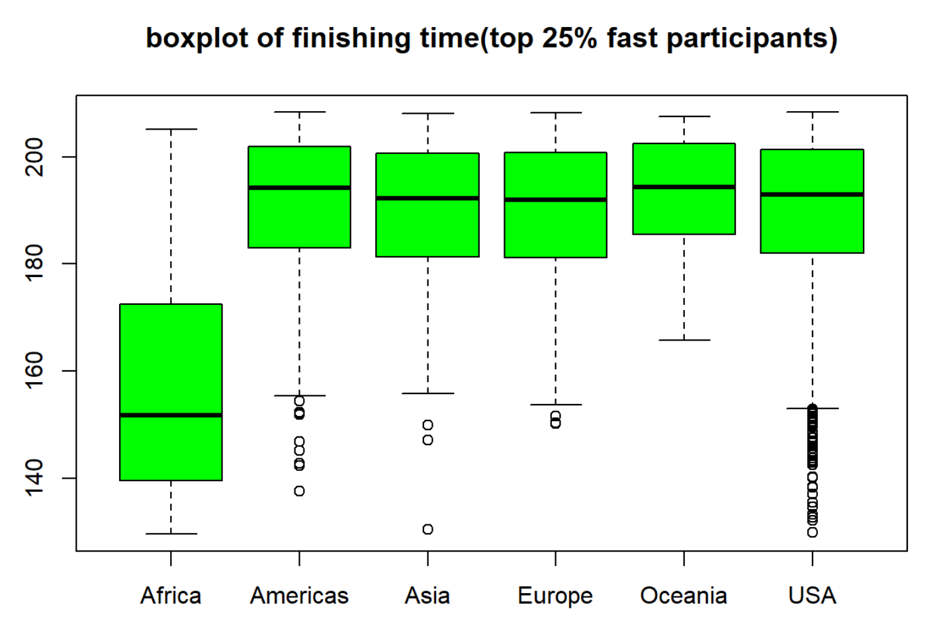
Continent ANOVA & Chi-Test Analysis
We randomly pick 50 samples from each group and do anova test. P value is very slow, so we reject the null hypothesis. Hoc test shows no difference in Oceania & Americas, Oceania & Europe.
For top 25% fast runners, p value is still small in anova test, and hoc test shows Africa is different from others
P value is small in chi-test, so continent has effect on Finish time.

Slide 14
Home State Analysis
How much does your home state affect your finishing time? Specific subquestions include:
How do runners from Massachusetts, the home state of the marathon, compare to the rest of the runners?
Are the top three states' average finishing times similar?
Are there states that are particularly faster or slower than others?
Are there any trends across different regions?

Slide 15
Home State Analysis Conclusions
We conducted an ANOVA analysis of the top 3 states (MA, NY, CA) and found a low p-value which caused us to reject the null hypothesis that there is no difference in means.
We conducted a two-sample T-test between average finishing times in New England vs the rest of the country, and found found a low p-value which caused us to reject the null hypothesis that there is no difference in means.
We conducted an ANOVA analysis of all non-New England states means and found a high p-value, which led us to not reject the null that there is no difference in mean.

Slide 16
Final Thoughts and Conclusions
Women’s finishing time is slower than men’s on average (228.9 vs 249.1 minutes)
How you do compared to others in the race for each quarter of the race (your rank each quarter) impacts your final rank. The last quarter ranking (30-42.195 kilometer segment) matters the most.
If the runner’s age is below 55, Age is really not a factor in deciding the finish run time of the marathon. However, older runners tend to runner slower.
Runners average finishing times over the last three years were about the same.
Runners that have run more than one Boston Marathon in 2015-2017 ran faster on average.
For nationality/continent, runners tend to finish in the same time, except for African runners who are much faster. The trend is even more significant when looking at just the top 25%.
Your home state has no significant impact on your final finishing time, unless you are from New England generally or Massachusetts specifically where average times are far slow. We can explore this trend by looking at a correlation between distance traveled and race time, or if charity runners (who do not have to qualify for the race) are more prevalent in New England.

